Slide 1
Whats the intent with activites?
Android stuffs

Slide 2

Android
Notes:
’Open Source’ (AOSP, Android Open Source Project)
Linux
Java dalvik vm and/or C,C++,Asm
Own UI toolkit, shares some parts of the framwork api with suns jre
SDK Free (Win, Mac, Linux), device debugging free, Market account $25

Slide 3

Activites
Notes:
Presentation layer, uses a view to define a layout
Layout defined in xml (htmlish) or from code
Navigate between activites by starting them and returning from them (stack)
http://www.flickr.com/photos/stuckincustoms/3946279121/sizes/l/in/photostream/

Slide 4
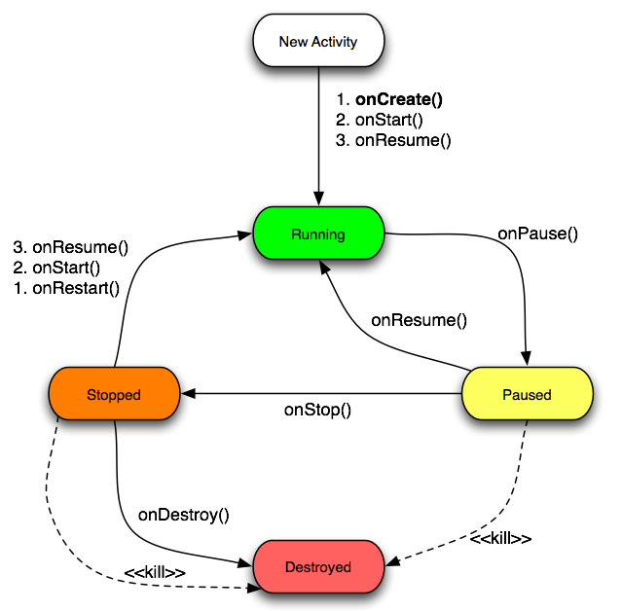
Activity lifecycle
Notes:
Priority: Visible (activity), services, background (activity w/o service)
Possible to save ui state

Slide 5

Intents
Notes:
Message passing within & between applications
Start activity/service to perform and action or broadcast event or start a activity/server
Startactivity / startactivityforresult
Onactivityresult callback
http://www.flickr.com/photos/craftydame/4383720879/sizes/l/in/photostream/

Slide 6
Move within an application
new Intent(MainActivity.this, FooActivity.class);
Notes:
From MainActivity start the activity FooActivity

Slide 7
Taking a Picture
new Intent(MediaStore.ACTION_IMAGE_CAPTURE);
Notes:
Starts the camera application and should return the uri to a image if one has been captured

Slide 8
Barcode Scanner
new Intent("com.google.zxing.client.android.SCAN");
Notes:
http://code.google.com/p/zxing/
Scans QR codes, regular barcodes etc
Returns a scanned barcode

Slide 9

Questions?
Notes:
Example projects with repo

